Slide 1
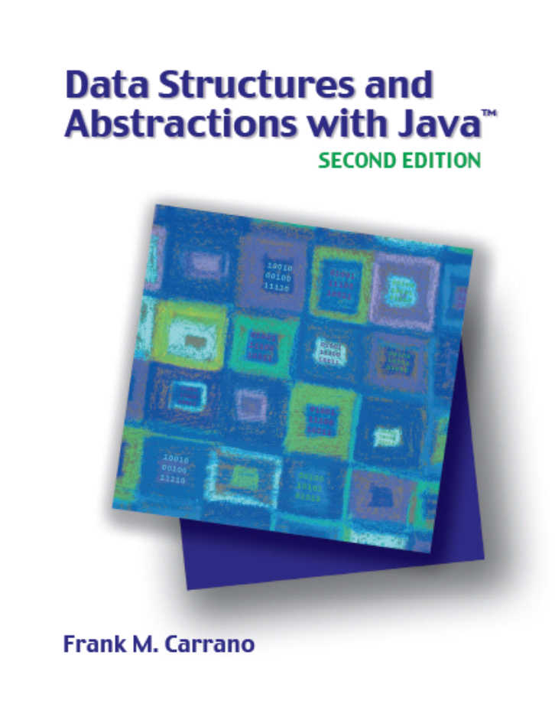

Balanced Search Trees
Chapter 29
Slides by Steve Armstrong
LeTourneau University
Longview, TX
© 2007, Prentice Hall

Slide 2
Chapter Contents
AVL Trees
  Single Rotations
  Double Rotations
  Implementation Details
2-3 Trees
  Searching
  Adding Entries to a 2-3 Tree
  Splitting Nodes During Addition
Carrano, Data Structures and Abstractions with Java, Second Edition, (c) 2007 Pearson Education, Inc. All rights reserved. 0-13-237045-X

Slide 3
Chapter Contents
2-4 Trees
  Adding Entries to a 2-4 Tree
  Comparing AVL, 2-3, and 2-4 Trees
Red-Black Trees
  Properties of a Red-Black Tree
  Adding Entries to a Red-Black Tree
  Java Class Library: the Class TreeMap
B-Trees
Carrano, Data Structures and Abstractions with Java, Second Edition, (c) 2007 Pearson Education, Inc. All rights reserved. 0-13-237045-X

Slide 4
AVL Trees
An AVL tree is a binary search tree
Whenever it becomes unbalanced
  Rearranges its nodes to get a balanced binary search tree
Balance of a binary search tree upset when
  Add a node
  Remove a node
Thus during these operations, the AVL tree must rearrange nodes to maintain balance
Carrano, Data Structures and Abstractions with Java, Second Edition, (c) 2007 Pearson Education, Inc. All rights reserved. 0-13-237045-X

Slide 5
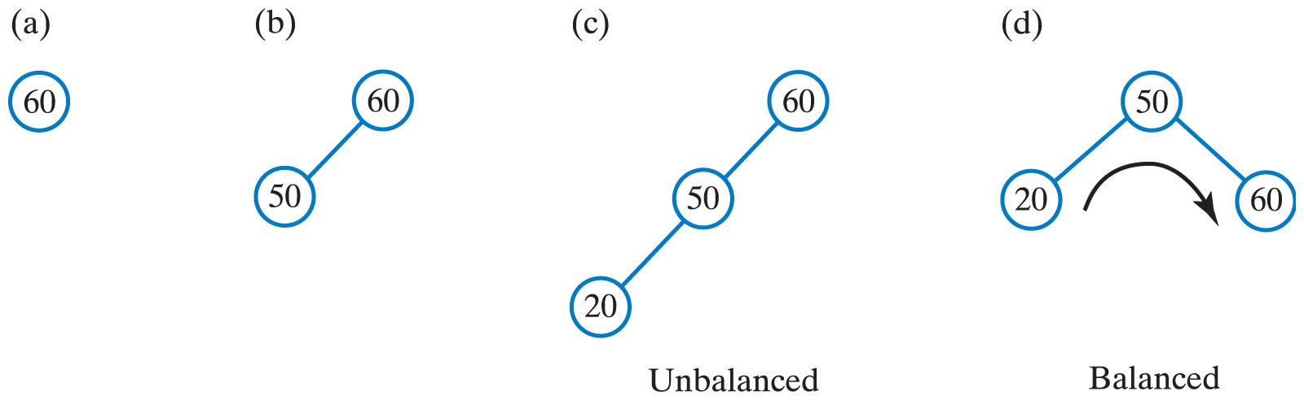
AVL Trees
Fig. 29-1 After inserting (a) 60; (b) 50; and (c) 20 into an initially empty binary search tree, the tree is not balanced; d) a corresponding AVL tree rotates its nodes to restore balance.
Carrano, Data Structures and Abstractions with Java, Second Edition, (c) 2007 Pearson Education, Inc. All rights reserved. 0-13-237045-X

Slide 6
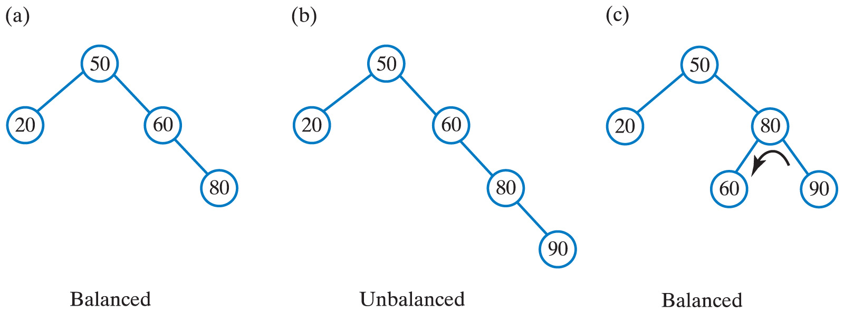
AVL Trees
Fig. 29-2 (a) Adding 80 to tree in Fig. 29-1d does not change the balance of the tree;
(b) a subsequent addition of 90 makes tree unbalanced; (c) left rotation restores balance.
Carrano, Data Structures and Abstractions with Java, Second Edition, (c) 2007 Pearson Education, Inc. All rights reserved. 0-13-237045-X

Slide 7
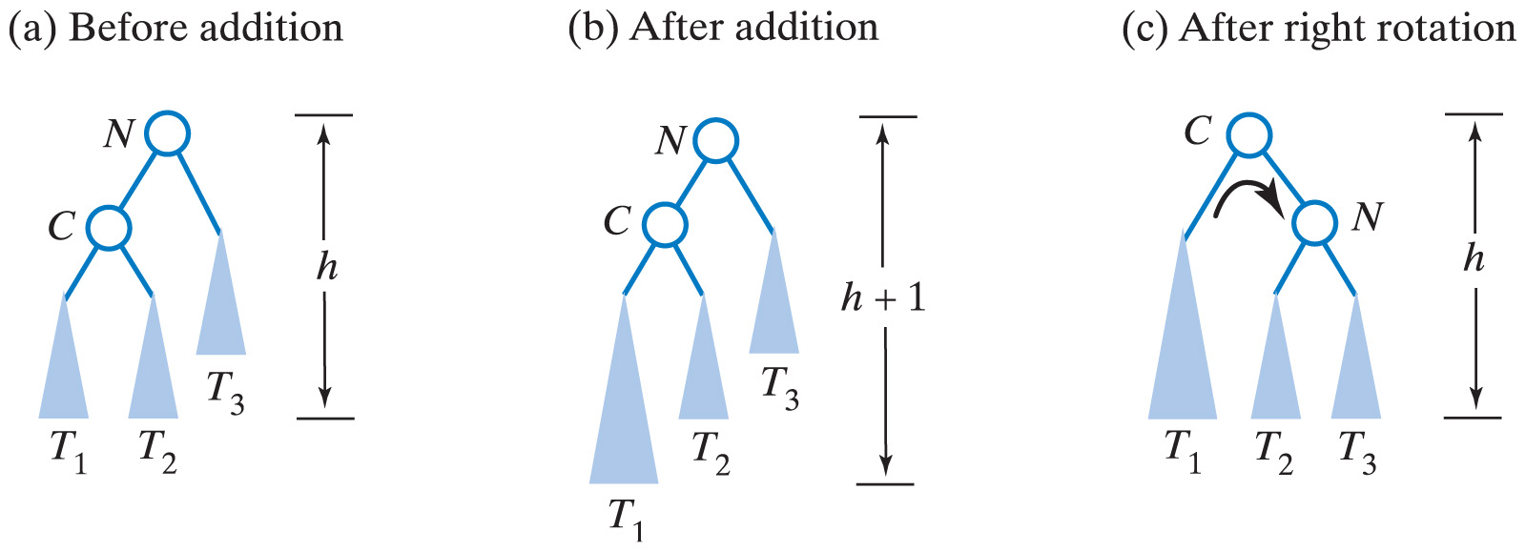
Single Rotations
Fig 28-3 Before and after an addition to an AVL subtree that requires a right rotation to maintain its balance.
Carrano, Data Structures and Abstractions with Java, Second Edition, (c) 2007 Pearson Education, Inc. All rights reserved. 0-13-237045-X

Slide 8
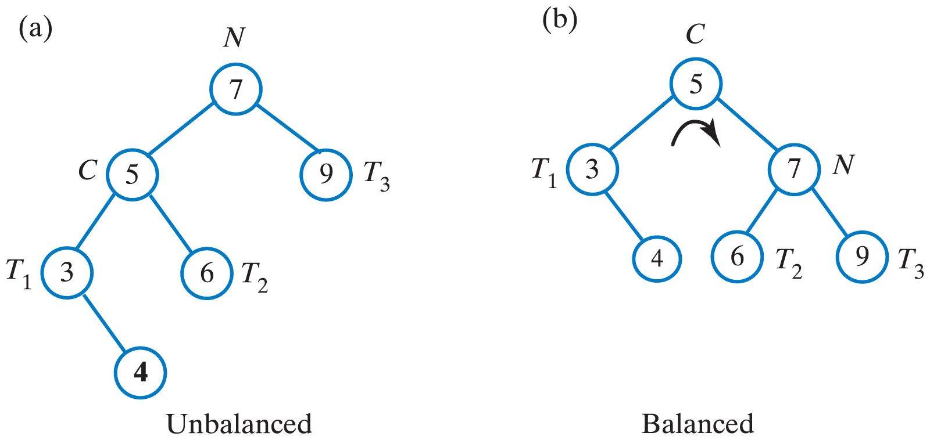
Single Rotations
Fig 28-4 Before and after a right rotation restores balance to an AVL tree
Carrano, Data Structures and Abstractions with Java, Second Edition, (c) 2007 Pearson Education, Inc. All rights reserved. 0-13-237045-X

Slide 9
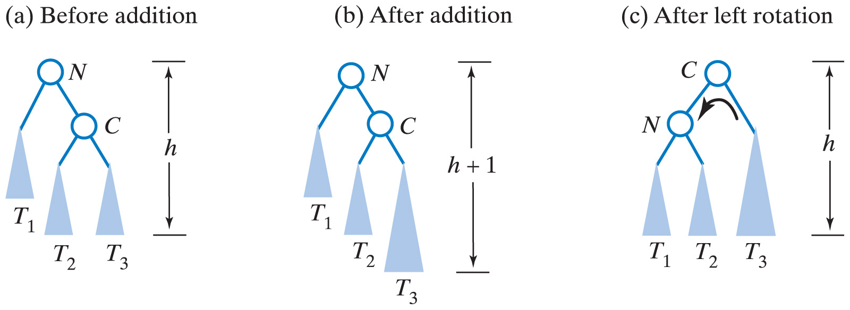
Single Rotations
Fig 28-5 Before and after an addition to an AVL subtree that requires a left rotation to maintain balance.
Carrano, Data Structures and Abstractions with Java, Second Edition, (c) 2007 Pearson Education, Inc. All rights reserved. 0-13-237045-X

Slide 10
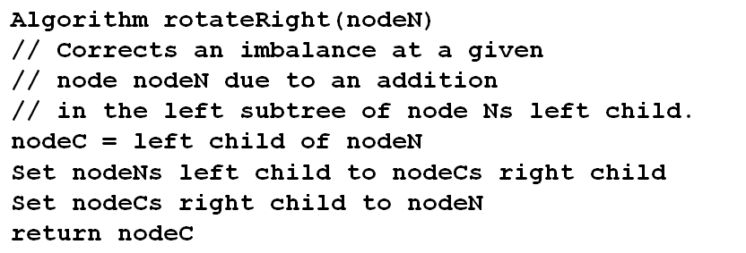
Single Rotations
Algorithm for right rotation
Carrano, Data Structures and Abstractions with Java, Second Edition, (c) 2007 Pearson Education, Inc. All rights reserved. 0-13-237045-X

Slide 11
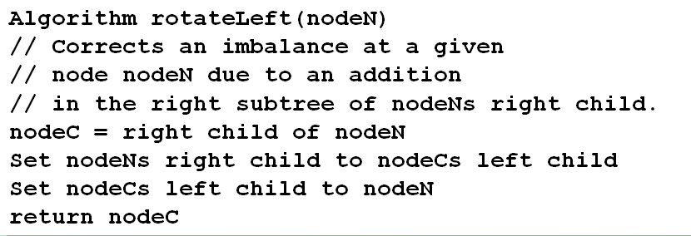
Single Rotations
Algorithm for left rotation
Carrano, Data Structures and Abstractions with Java, Second Edition, (c) 2007 Pearson Education, Inc. All rights reserved. 0-13-237045-X

Slide 12
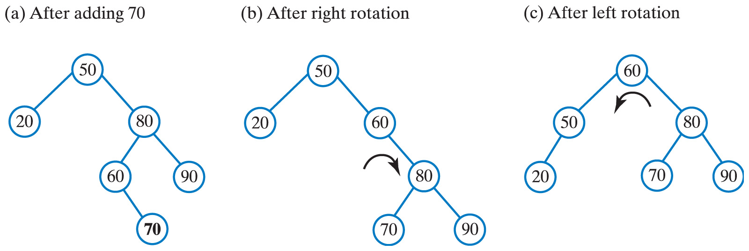
Double Rotations
Fig. 29-6 (a) Adding 70 to the tree in Fig. 29-2c destroys its balance; to restore the balance, perform both
(b) a right rotation and (c) a left rotation.
Carrano, Data Structures and Abstractions with Java, Second Edition, (c) 2007 Pearson Education, Inc. All rights reserved. 0-13-237045-X

Slide 13
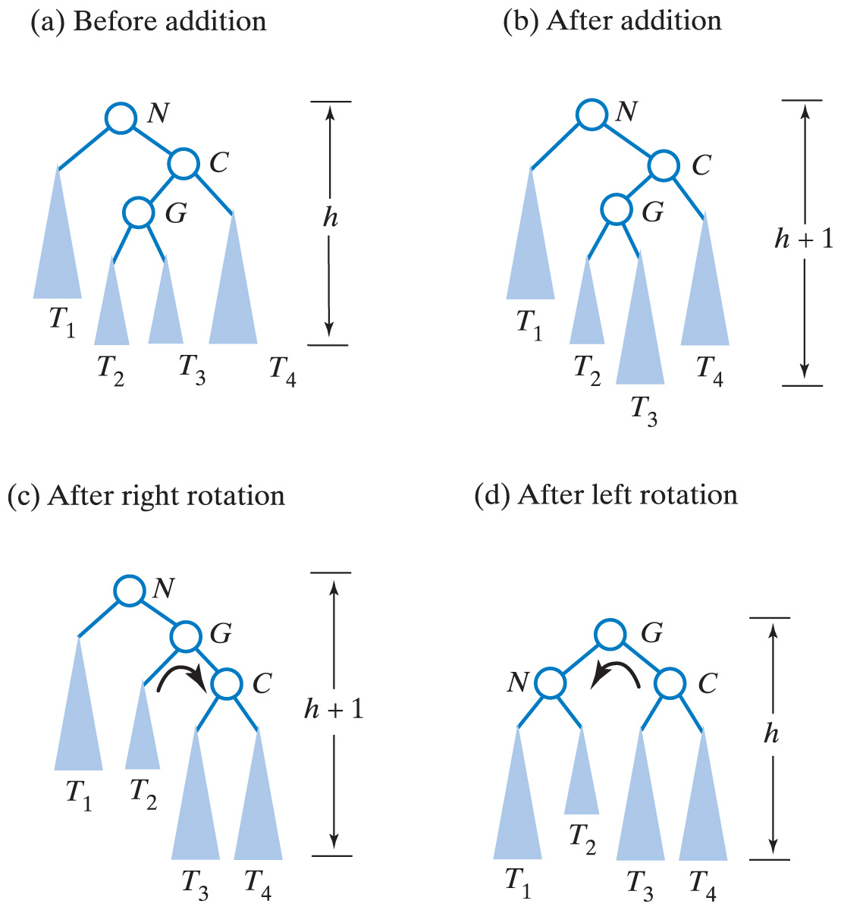
Double Rotations
Fig. 29-7 (a-b) Before and after an addition to an AVL subtree that requires both a right rotation and a left rotation to maintain its balance.
Carrano, Data Structures and Abstractions with Java, Second Edition, (c) 2007 Pearson Education, Inc. All rights reserved. 0-13-237045-X

Slide 14
Double Rotations
Fig. 29-7 (c-d) Before and after an addition to an AVL subtree that requires both a right rotation and a left rotation to maintain its balance.
Carrano, Data Structures and Abstractions with Java, Second Edition, (c) 2007 Pearson Education, Inc. All rights reserved. 0-13-237045-X

Slide 15
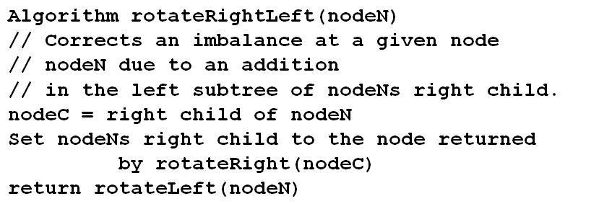
Double Rotations
Algorithm to perform the right-left double rotation illustrated in Fig. 29-7
Carrano, Data Structures and Abstractions with Java, Second Edition, (c) 2007 Pearson Education, Inc. All rights reserved. 0-13-237045-X

Slide 16
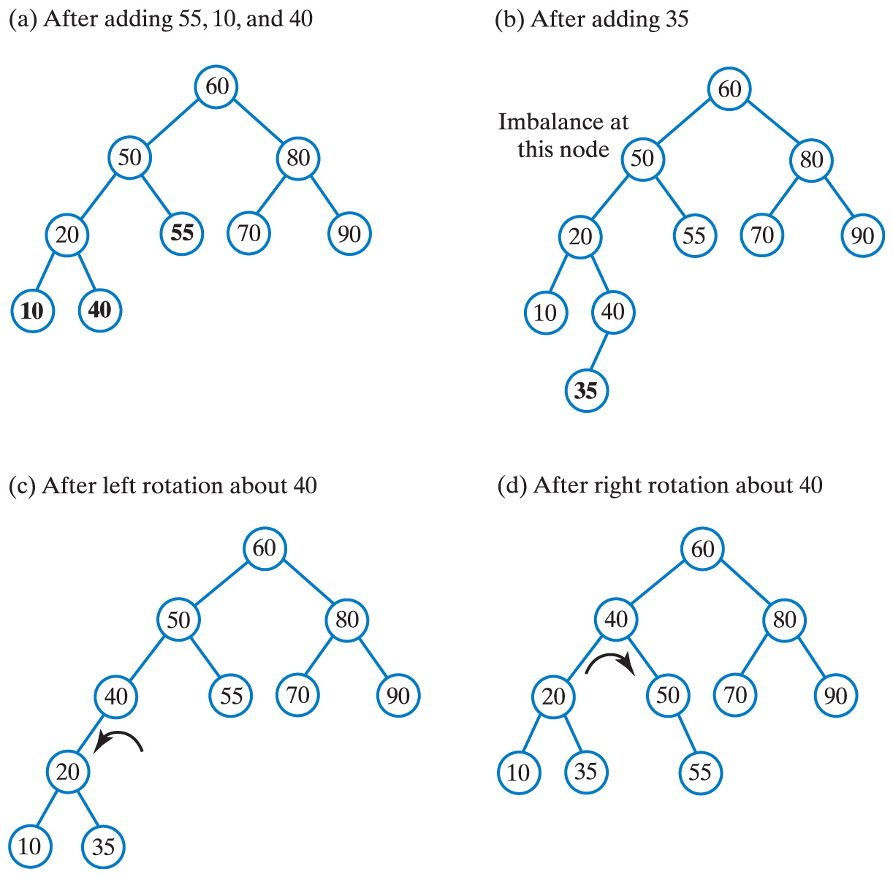
Double Rotations
Fig. 29-8 (a) The AVL tree in Fig. 29-6 after additions that maintain its balance; (b) after an addition that destroys the balance … continued →
Carrano, Data Structures and Abstractions with Java, Second Edition, (c) 2007 Pearson Education, Inc. All rights reserved. 0-13-237045-X

Slide 17
Double Rotations
Fig. 29-7 (ctd.) (c) after a left rotation;
(d) after a right rotation.
Carrano, Data Structures and Abstractions with Java, Second Edition, (c) 2007 Pearson Education, Inc. All rights reserved. 0-13-237045-X

Slide 18
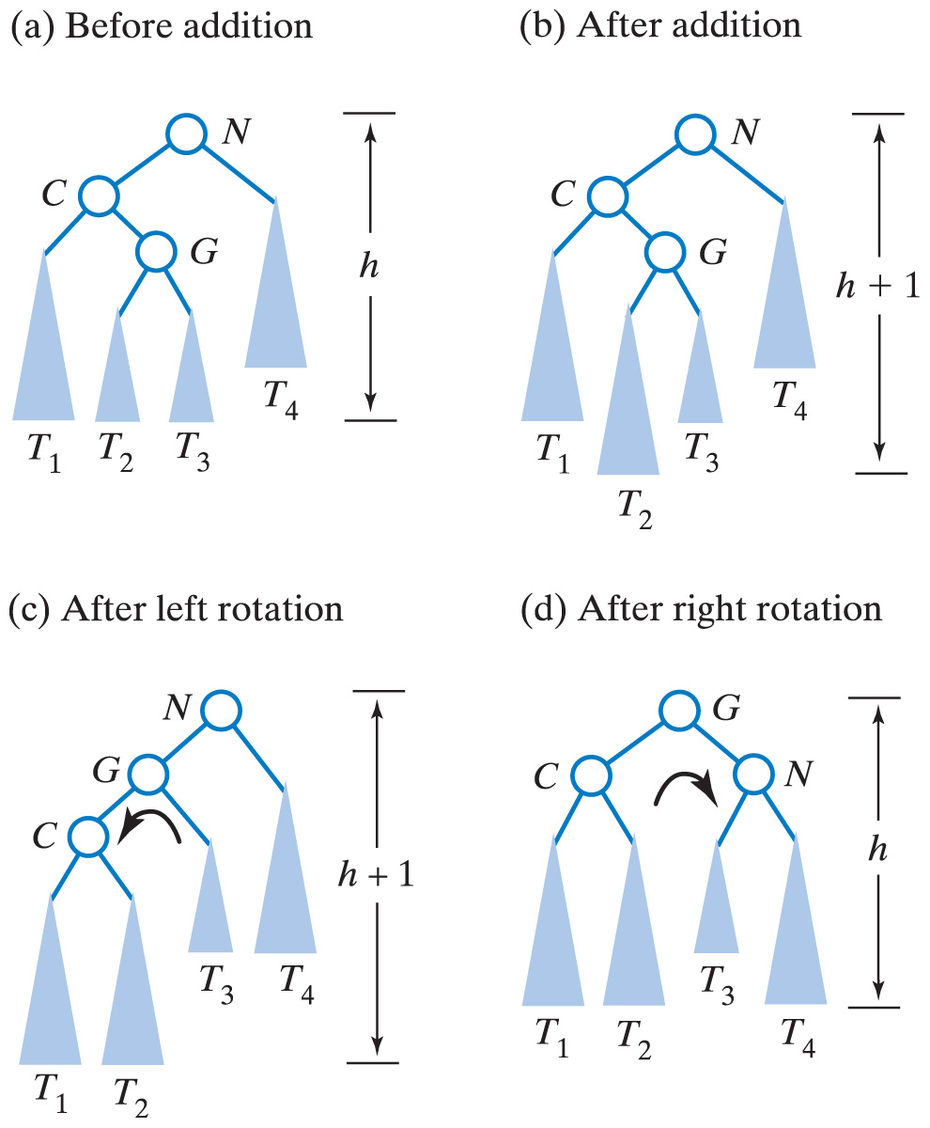
Double Rotations
Fig. 29-9 Before and after an addition to an AVL subtree that requires both a left and right rotation to maintain its balance.
Carrano, Data Structures and Abstractions with Java, Second Edition, (c) 2007 Pearson Education, Inc. All rights reserved. 0-13-237045-X

Slide 19
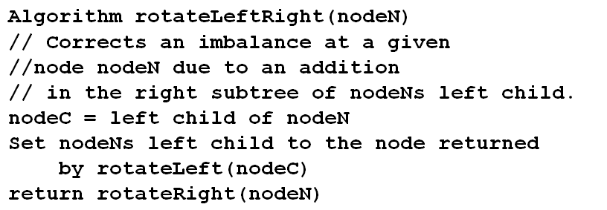
Double Rotations
Algorithm to perform the left-right double rotation illustrated in Fig. 29-9
Carrano, Data Structures and Abstractions with Java, Second Edition, (c) 2007 Pearson Education, Inc. All rights reserved. 0-13-237045-X

Slide 20
Double Rotations
An imbalance at node N of an AVL tree can be corrected by a double rotation if
  The addition occurred in the left subtree of N's right child (left-right rotation) or …
  The addition occurred in the right subtree of N's left child (left-right rotation)
A double rotation is accomplished by performing two single rotations
  A rotation about N's grandchild
  A rotation about node N's new child
Carrano, Data Structures and Abstractions with Java, Second Edition, (c) 2007 Pearson Education, Inc. All rights reserved. 0-13-237045-X

Slide 21
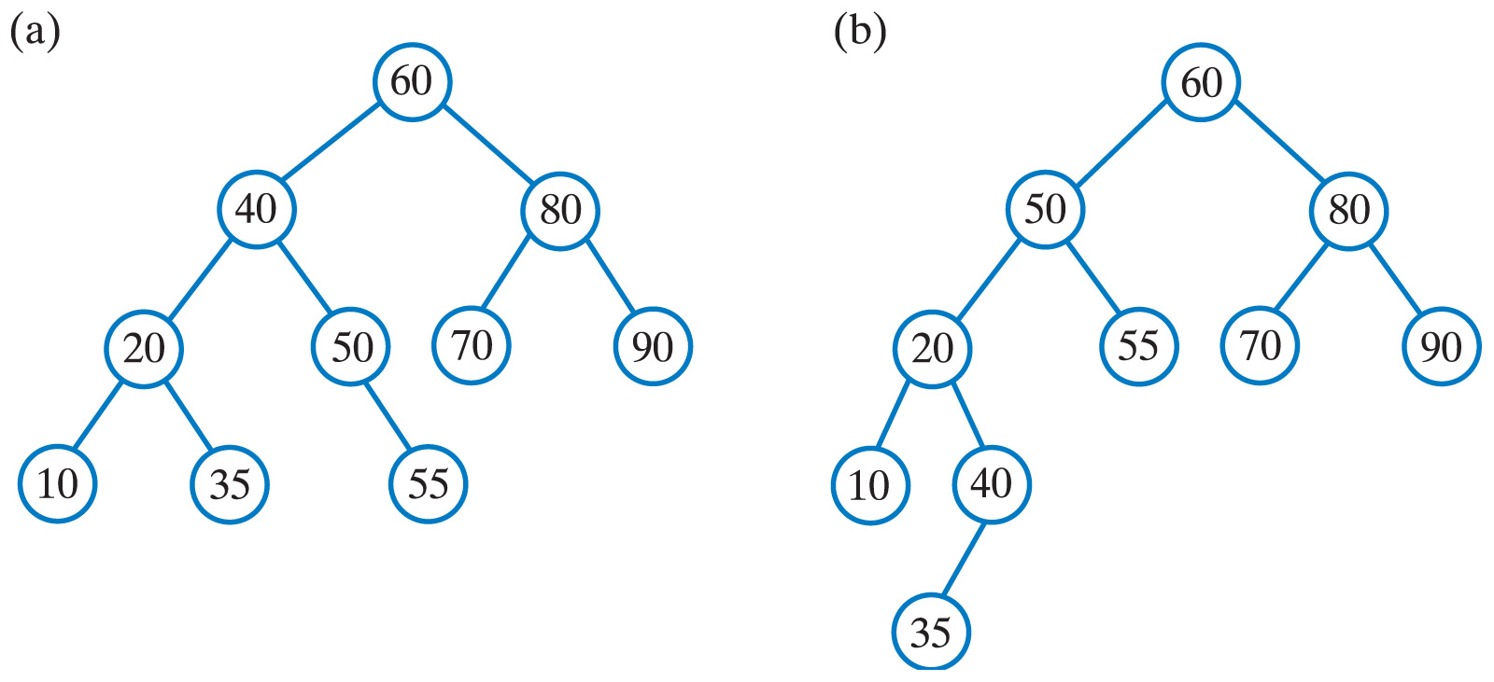
Double Rotations
Click to view outline of class AVLTree
Fig. 29-10 The result of adding 60, 50, 20, 80, 90, 70,
55, 10, 40, and 35 to an initially empty
(a) AVL tree; (b) binary search tree.
Carrano, Data Structures and Abstractions with Java, Second Edition, (c) 2007 Pearson Education, Inc. All rights reserved. 0-13-237045-X

Slide 22
2 – 3 Trees
A general search tree
Interior nodes must have either 2 or 3 children
A 2-node
  Contains one data item s
  Has 2 children
  The data item s > data in left sub tree
  The data item s < data in right sub tree
A 3-node
  Contains 2 data items, s (the smaller) and l (the larger)
  Has 3 children
  Data < s is in left subtree
  Data > l is in right subtree
  When s < data < l, occurs in middle subtree
Carrano, Data Structures and Abstractions with Java, Second Edition, (c) 2007 Pearson Education, Inc. All rights reserved. 0-13-237045-X

Slide 23
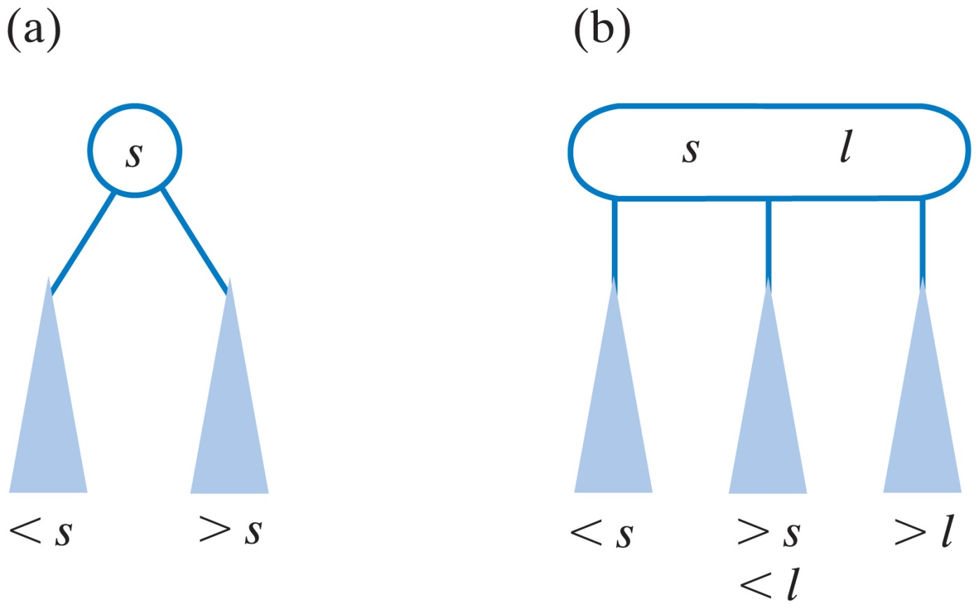
2 – 3 Trees
A 2-3 tree is completely balanced.
Fig. 29-11 (a) a 2-node; (b) a 3-node.
Carrano, Data Structures and Abstractions with Java, Second Edition, (c) 2007 Pearson Education, Inc. All rights reserved. 0-13-237045-X

Slide 24
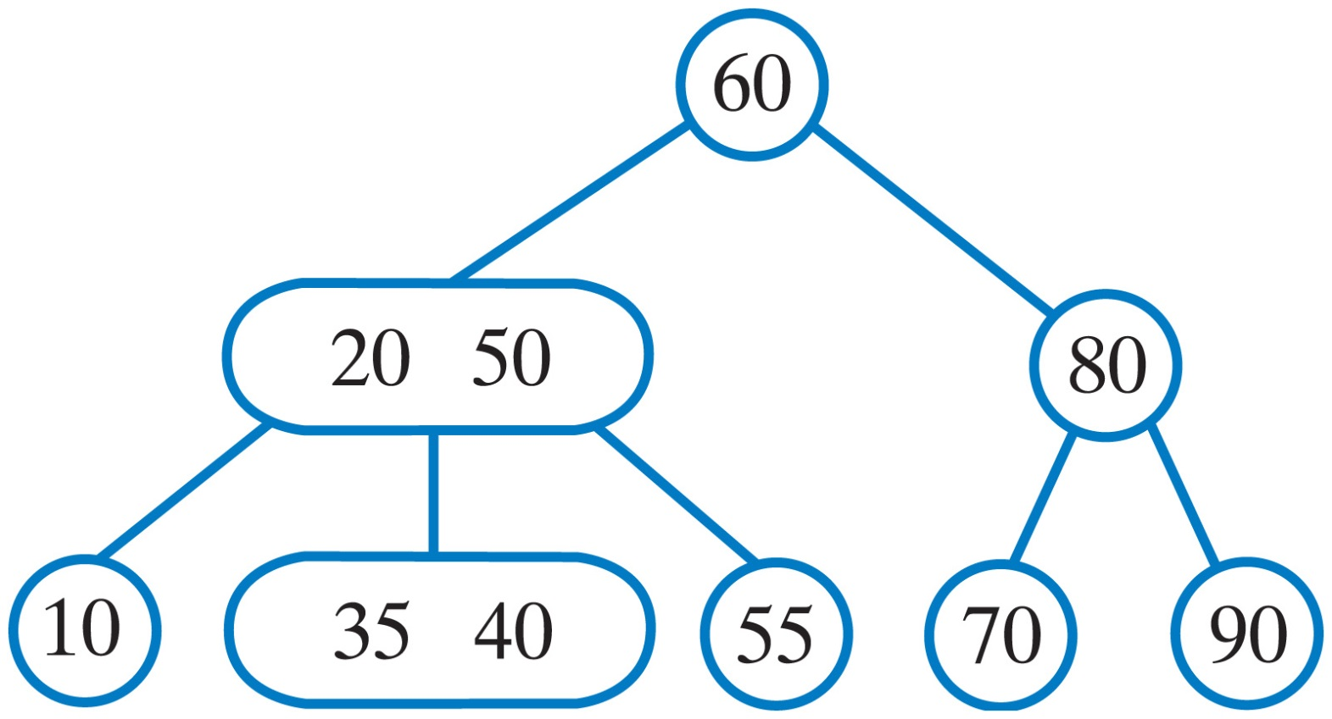
2 – 3 Trees
The search algorithm for a 2-3 tree is an extension of the search algorithm for a binary search tree.
Fig. 29-12 A 2-3 tree.
Carrano, Data Structures and Abstractions with Java, Second Edition, (c) 2007 Pearson Education, Inc. All rights reserved. 0-13-237045-X

Slide 25
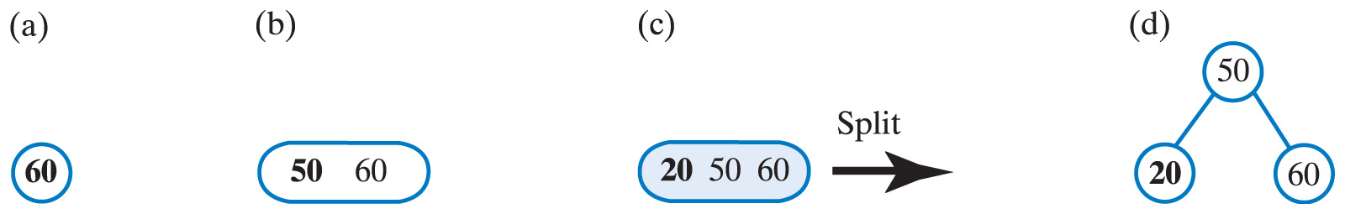
Adding Entries to a 2-3 Tree
Fig. 29-13 An initially empty 2-3 tree after adding (a) 60 and (b) 50; (c), (d) adding 20 causes the 3-node to split.
Carrano, Data Structures and Abstractions with Java, Second Edition, (c) 2007 Pearson Education, Inc. All rights reserved. 0-13-237045-X

Slide 26
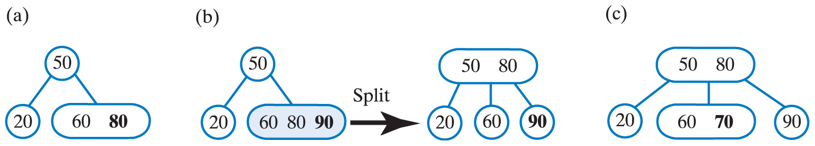
Adding Entries to a 2-3 Tree
Fig. 29-14 The 2-3 tree after adding (a) 80; (b) 90; (e) 70.
Carrano, Data Structures and Abstractions with Java, Second Edition, (c) 2007 Pearson Education, Inc. All rights reserved. 0-13-237045-X

Slide 27
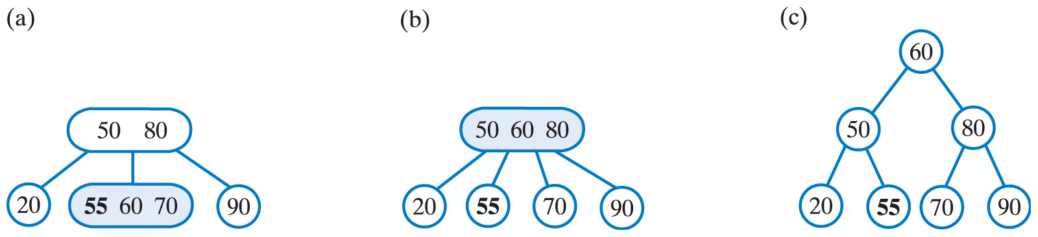
Adding Entries to a 2-3 Tree
Fig. 29-15 Adding 55 to the 2-3 tree causes a leaf and then the root to split.
Carrano, Data Structures and Abstractions with Java, Second Edition, (c) 2007 Pearson Education, Inc. All rights reserved. 0-13-237045-X

Slide 28
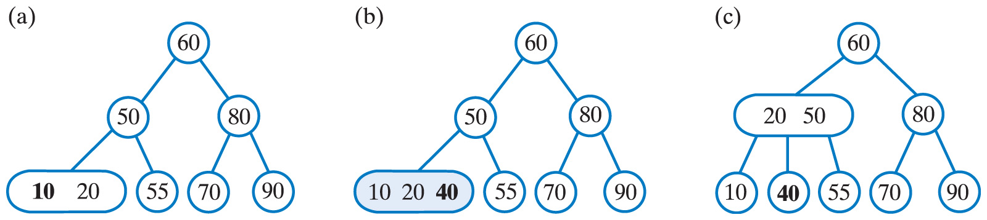
Adding Entries to a 2-3 Tree
Fig. 29-16 The 2-3 tree after adding
(a) 10; (b), (c) 40.
Carrano, Data Structures and Abstractions with Java, Second Edition, (c) 2007 Pearson Education, Inc. All rights reserved. 0-13-237045-X

Slide 29
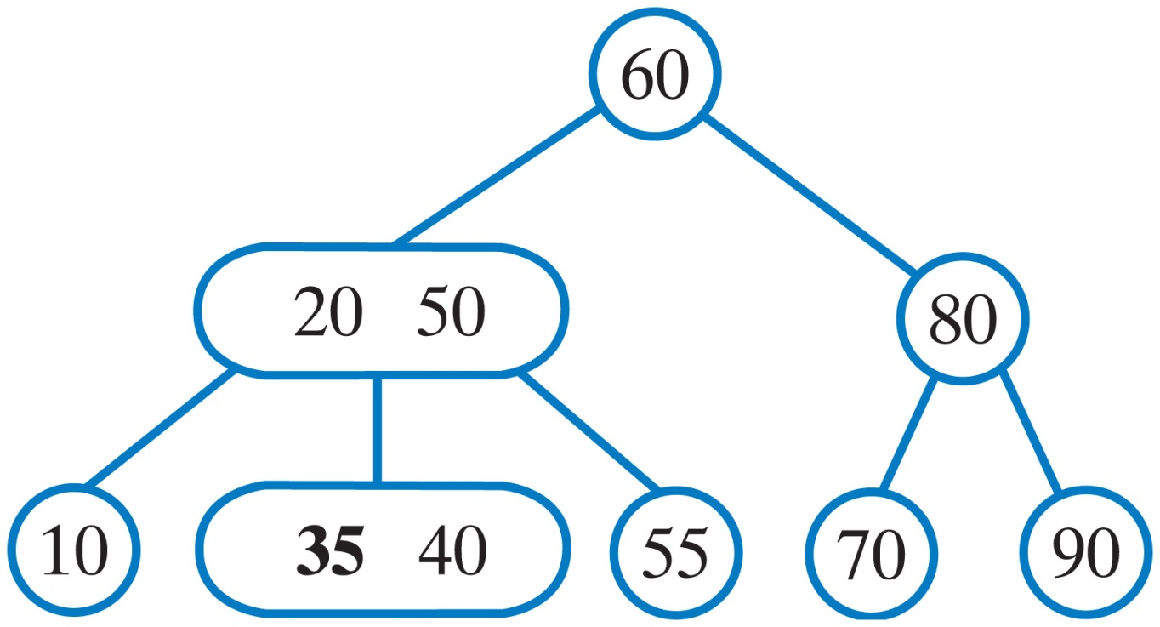
Adding Entries to a 2-3 Tree
Fig. 29-17 The 2-3 tree after adding 35.
Carrano, Data Structures and Abstractions with Java, Second Edition, (c) 2007 Pearson Education, Inc. All rights reserved. 0-13-237045-X

Slide 30
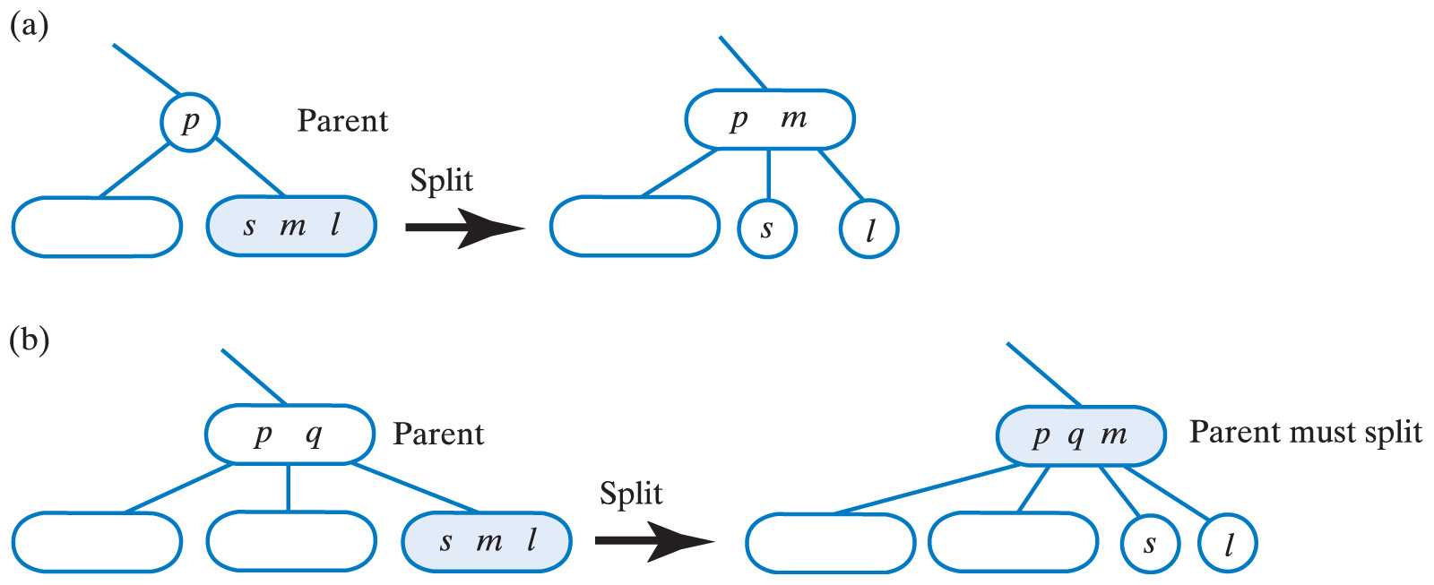
Splitting a Leaf
The first node to split is leaf that already contains two entries
Fig. 29-18 Splitting a leaf to accommodate a new entry when the leaf's parent contains
(a) one entry
Carrano, Data Structures and Abstractions with Java, Second Edition, (c) 2007 Pearson Education, Inc. All rights reserved. 0-13-237045-X

Slide 31

Splitting a Leaf
The first node to split is leaf that already contains two entries
Split
Fig. 29-18 Splitting a leaf to accommodate a new entry when the leaf's parent contains
(b) two entries
Carrano, Data Structures and Abstractions with Java, Second Edition, (c) 2007 Pearson Education, Inc. All rights reserved. 0-13-237045-X

Slide 32
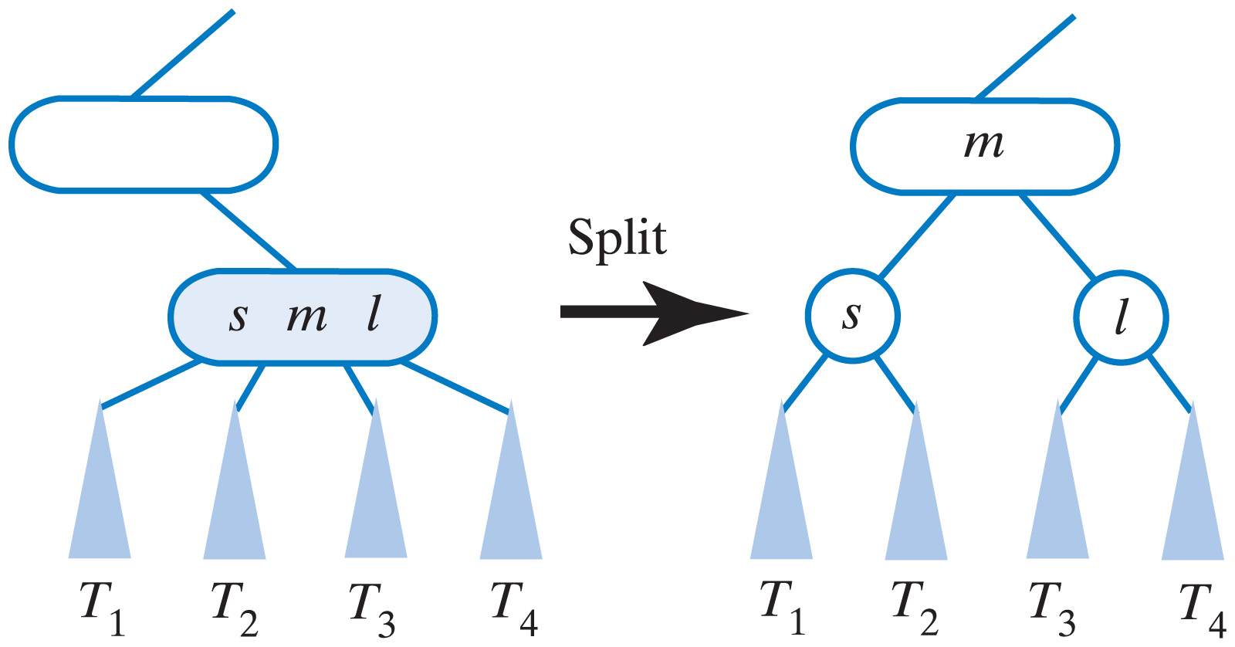
Splitting a Leaf
Fig. 29-19 Splitting an internal node to accommodate a new entry.
Carrano, Data Structures and Abstractions with Java, Second Edition, (c) 2007 Pearson Education, Inc. All rights reserved. 0-13-237045-X

Slide 33
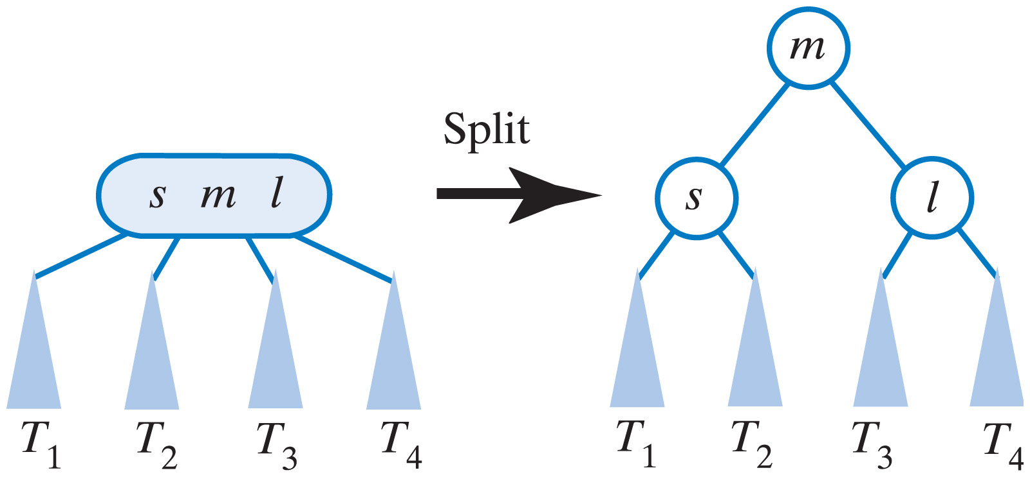
Splitting a Leaf
Fig. 29-20 Splitting the root to accommodate a new entry.
Carrano, Data Structures and Abstractions with Java, Second Edition, (c) 2007 Pearson Education, Inc. All rights reserved. 0-13-237045-X

Slide 34
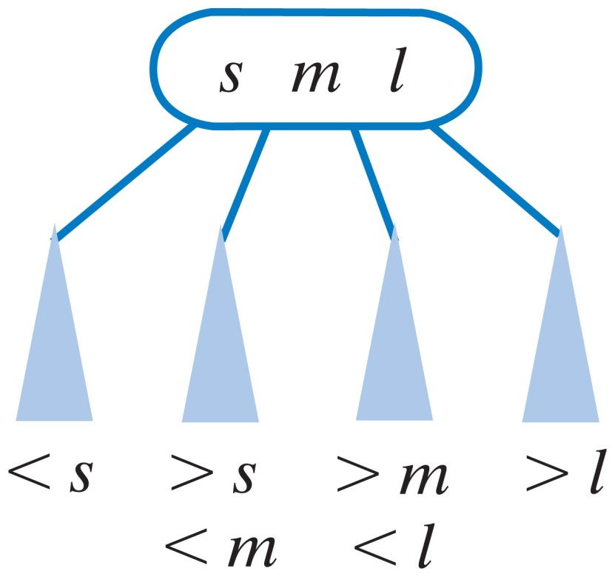
2-4 Trees
A general search tree
Interior nodes must have 2, 3, or 4 children
Leaves occur on the same level
Completely balance
Fig. 29-21 A 4-node.
Carrano, Data Structures and Abstractions with Java, Second Edition, (c) 2007 Pearson Education, Inc. All rights reserved. 0-13-237045-X

Slide 35
Adding Entries to a 2-4 Tree
When adding entries to a 2-4 tree
  Split any 4-node as soon as you encounter it during the search for the new entry's position in the tree
  The addition is complete right after this search ends
Adding to a 2-4 tree is more efficient than adding to a 2-3 tree.
Carrano, Data Structures and Abstractions with Java, Second Edition, (c) 2007 Pearson Education, Inc. All rights reserved. 0-13-237045-X

Slide 36
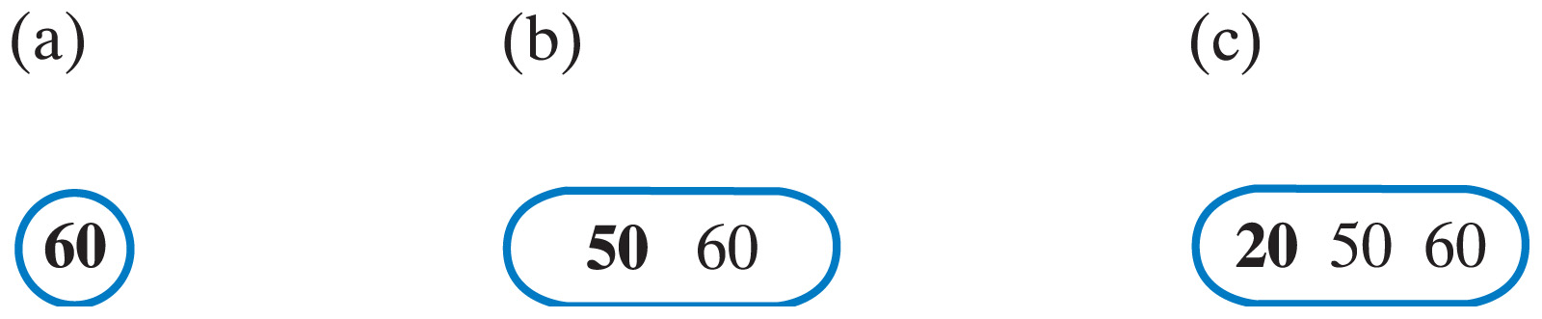
Adding Entries to a 2-4 Tree
Fig. 29-22 An initially empty 2-4 tree after adding
(a) 60; (b) 50; (c) 20.
Carrano, Data Structures and Abstractions with Java, Second Edition, (c) 2007 Pearson Education, Inc. All rights reserved. 0-13-237045-X

Slide 37
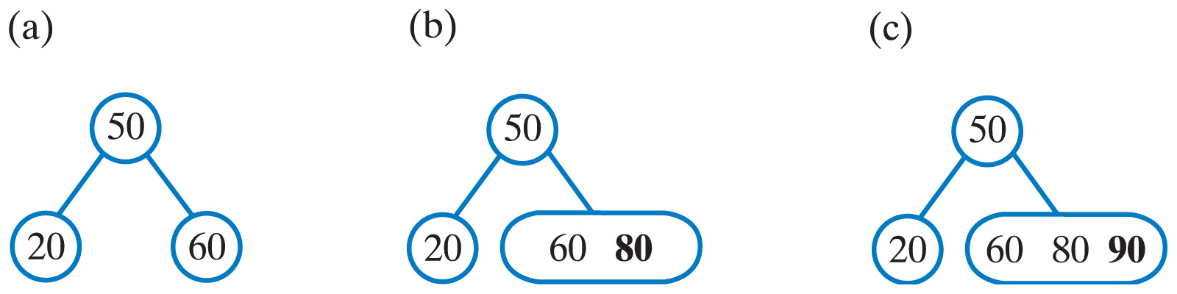
Adding Entries to a 2-4 Tree
Fig. 29-23 The 2-4 tree after (a) splitting the root;
(b) adding 80; (c) adding 90.
Carrano, Data Structures and Abstractions with Java, Second Edition, (c) 2007 Pearson Education, Inc. All rights reserved. 0-13-237045-X

Slide 38
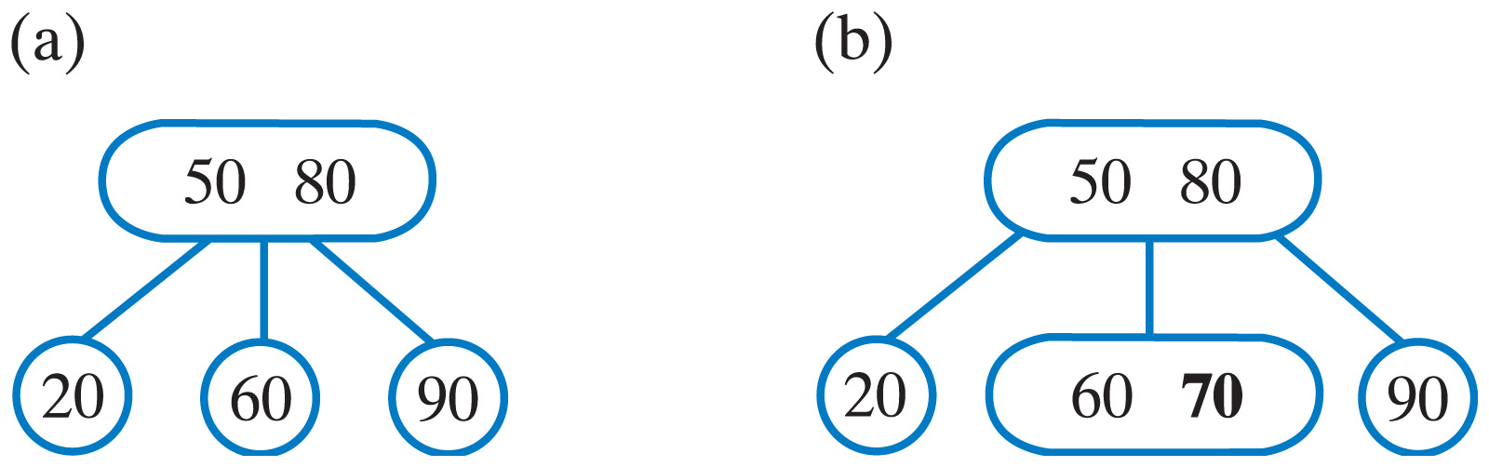
Adding Entries to a 2-4 Tree
Fig. 29-24 The 2-4 tree after (a) splitting a 4-node;
(b) adding 70.
Carrano, Data Structures and Abstractions with Java, Second Edition, (c) 2007 Pearson Education, Inc. All rights reserved. 0-13-237045-X

Slide 39
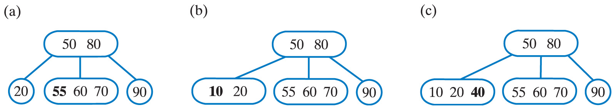
Adding Entries to a 2-4 Tree
Fig. 29-25 The 2-4 tree after adding
(a) 55; (b) 10; (c) 40.
Carrano, Data Structures and Abstractions with Java, Second Edition, (c) 2007 Pearson Education, Inc. All rights reserved. 0-13-237045-X

Slide 40
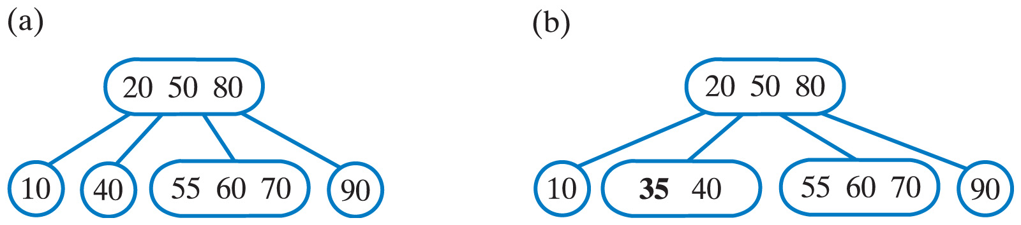
Adding Entries to a 2-4 Tree
Fig. 29-26 The 2-4 tree after
(a) splitting the leftmost 4-node; (b) adding 35.
Carrano, Data Structures and Abstractions with Java, Second Edition, (c) 2007 Pearson Education, Inc. All rights reserved. 0-13-237045-X

Slide 41
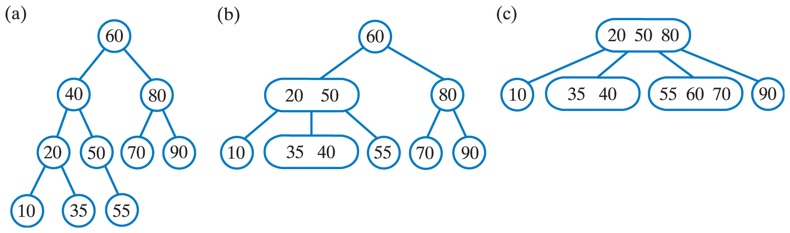
Comparing AVL, 2-3, and 2-4 Trees
Fig. 29-27 Three balanced search trees obtained by adding 60, 50, 20, 80, 90, 70, 55, 10, 40, and 35;
(a) AVL; (b) 2-3; (c) 2-4.
Carrano, Data Structures and Abstractions with Java, Second Edition, (c) 2007 Pearson Education, Inc. All rights reserved. 0-13-237045-X

Slide 42
Red-Black Trees
A binary equivalent to a 2-4 tree
Conceptually more involved than a 2-4 tree
Implementation uses only 2-nodes
  Thus more efficient
Carrano, Data Structures and Abstractions with Java, Second Edition, (c) 2007 Pearson Education, Inc. All rights reserved. 0-13-237045-X

Slide 43
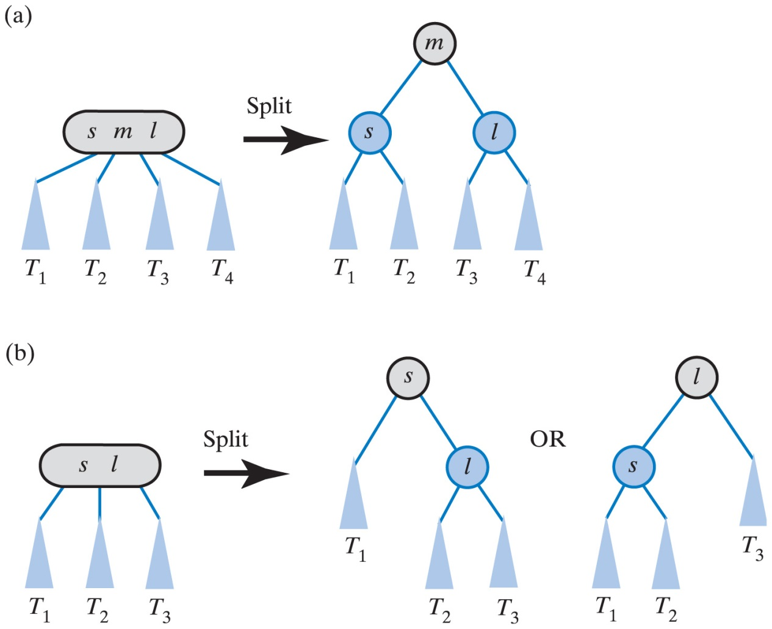
Red-Black Trees
Fig. 29-28 Using 2-nodes to represent
(a) a 4-node; (b) a 3-node.
Carrano, Data Structures and Abstractions with Java, Second Edition, (c) 2007 Pearson Education, Inc. All rights reserved. 0-13-237045-X

Slide 44
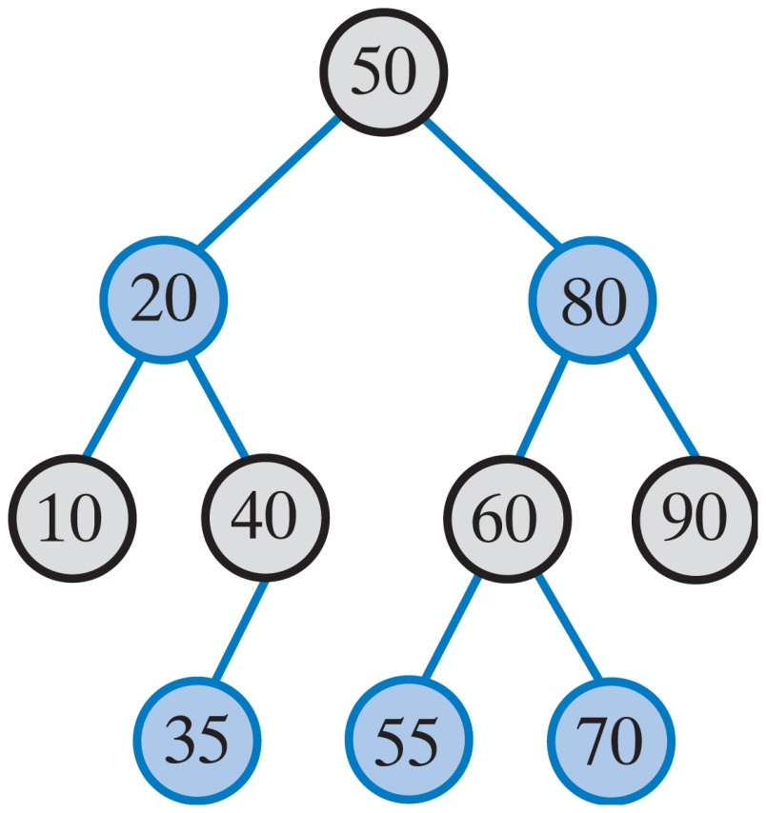
Red-Black Trees
Fig. 29-29 A red-black tree that is equivalent to the 2-4 tree in Fig. 29-26b.
Carrano, Data Structures and Abstractions with Java, Second Edition, (c) 2007 Pearson Education, Inc. All rights reserved. 0-13-237045-X

Slide 45
Properties of a Red-Black Tree
The root is black
Every red node has a black parent
Any children of a red node are black
  A red node cannot have red children
Every path from the root to a leaf contains the same number of black nodes
Carrano, Data Structures and Abstractions with Java, Second Edition, (c) 2007 Pearson Education, Inc. All rights reserved. 0-13-237045-X

Slide 46
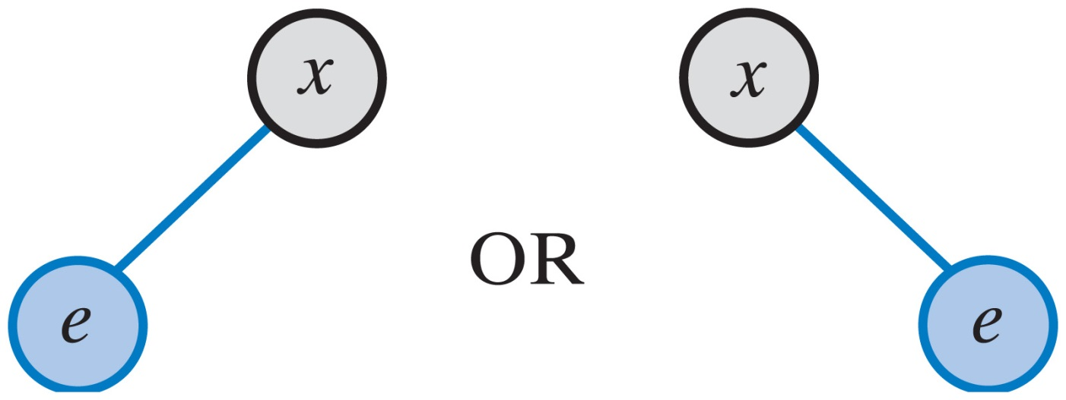
Adding Entries to a Red-Black Tree
Fig. 29-30 The result of adding a new entry e to a one-node red-black tree.
Carrano, Data Structures and Abstractions with Java, Second Edition, (c) 2007 Pearson Education, Inc. All rights reserved. 0-13-237045-X

Slide 47
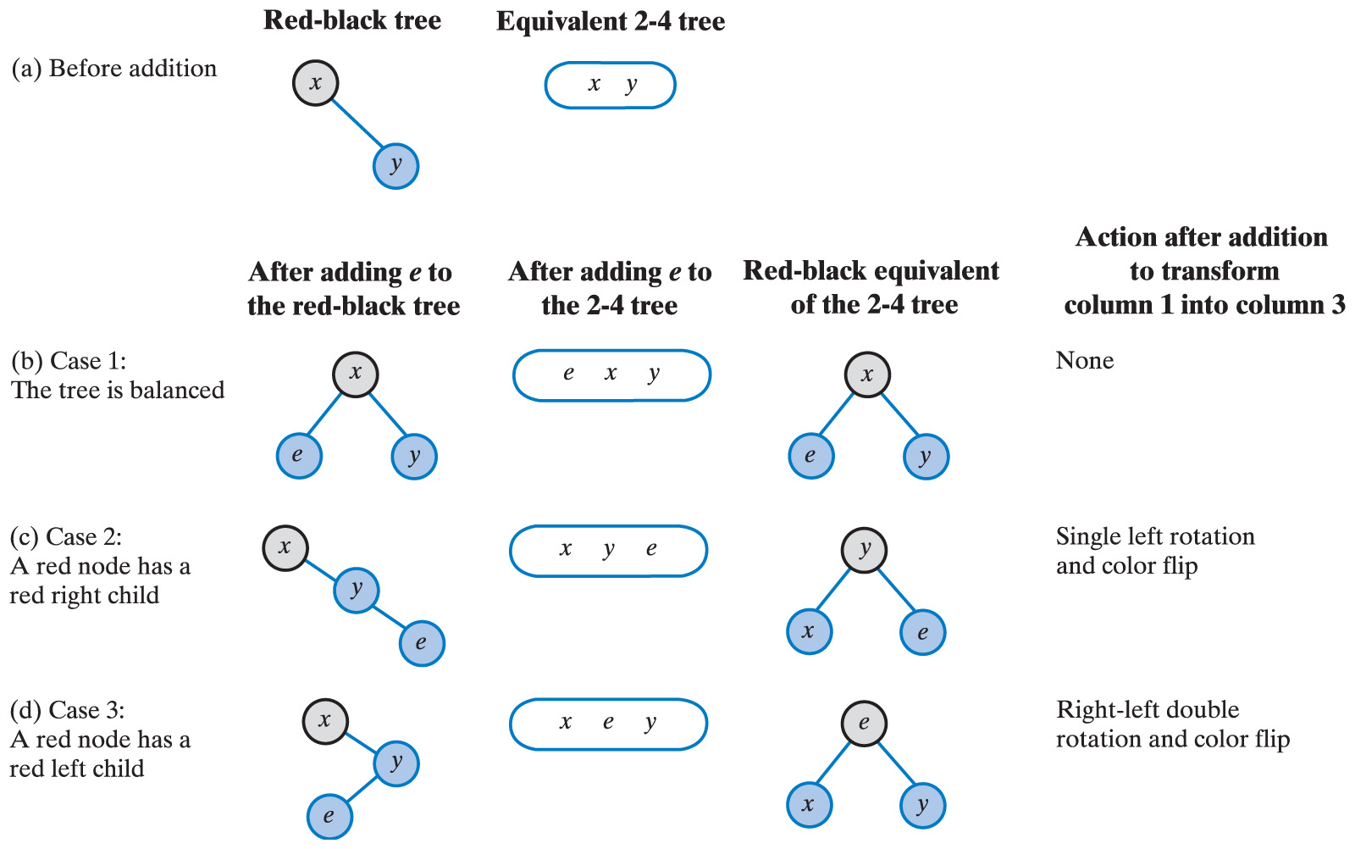
Adding Entries to a Red-Black Tree
Fig. 29-31 The possible results of adding a new entry e to a two-node red-black tree ... continued →
Carrano, Data Structures and Abstractions with Java, Second Edition, (c) 2007 Pearson Education, Inc. All rights reserved. 0-13-237045-X

Slide 48
Adding Entries to a Red-Black Tree
Fig. 29-31 (ctd.) The possible results of adding a new entry e to a two-node red-black tree.
Carrano, Data Structures and Abstractions with Java, Second Edition, (c) 2007 Pearson Education, Inc. All rights reserved. 0-13-237045-X

Slide 49
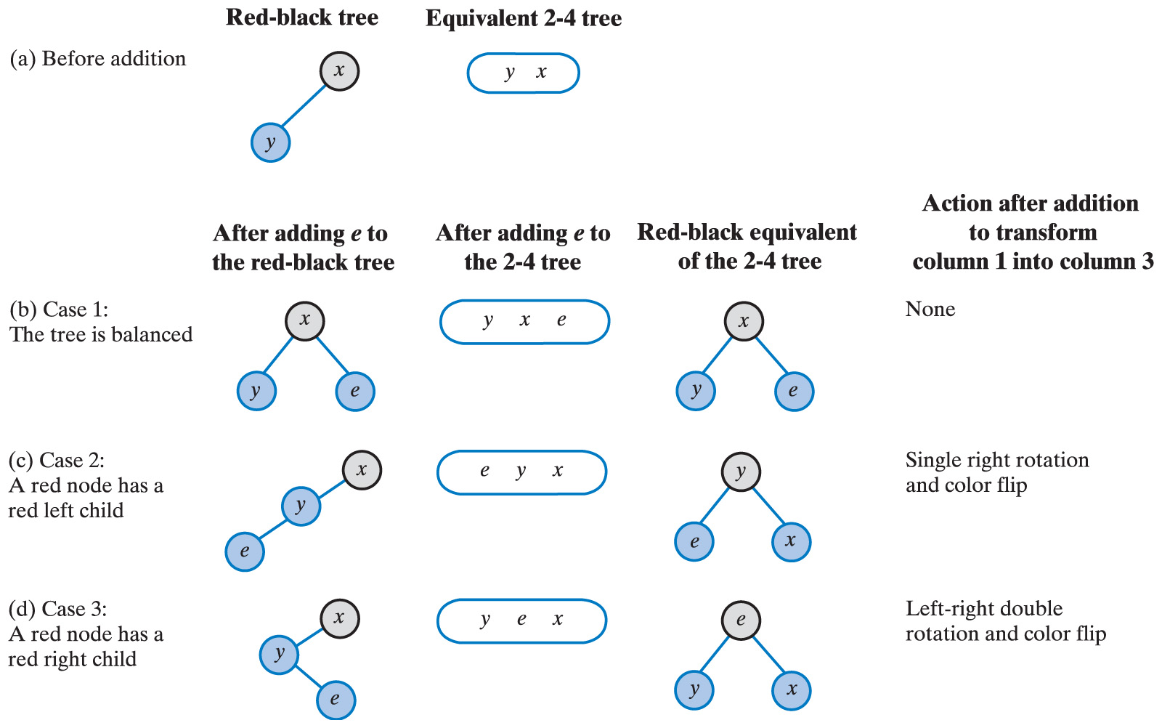
Adding Entries to a Red-Black Tree
Fig. 29-32 The possible results of adding a new entry e to a two-node red-black tree: Mirror images of Fig. 29-31 … continued →
Carrano, Data Structures and Abstractions with Java, Second Edition, (c) 2007 Pearson Education, Inc. All rights reserved. 0-13-237045-X

Slide 50
Adding Entries to a Red-Black Tree
Fig. 29-32 (ctd.) The possible results of adding a new entry e to a two-node red-black tree: Mirror images of Fig. 29-31.
Carrano, Data Structures and Abstractions with Java, Second Edition, (c) 2007 Pearson Education, Inc. All rights reserved. 0-13-237045-X

Slide 51
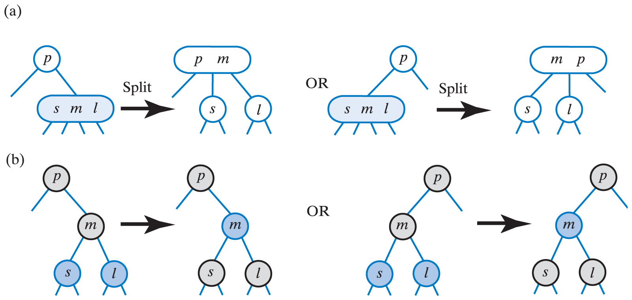
Adding Entries to a Red-Black Tree
Fig. 29-33 Splitting a 4-node whose parent is a
2-node in (a) a 2-4 tree; (b) a red-black tree.
Carrano, Data Structures and Abstractions with Java, Second Edition, (c) 2007 Pearson Education, Inc. All rights reserved. 0-13-237045-X

Slide 52
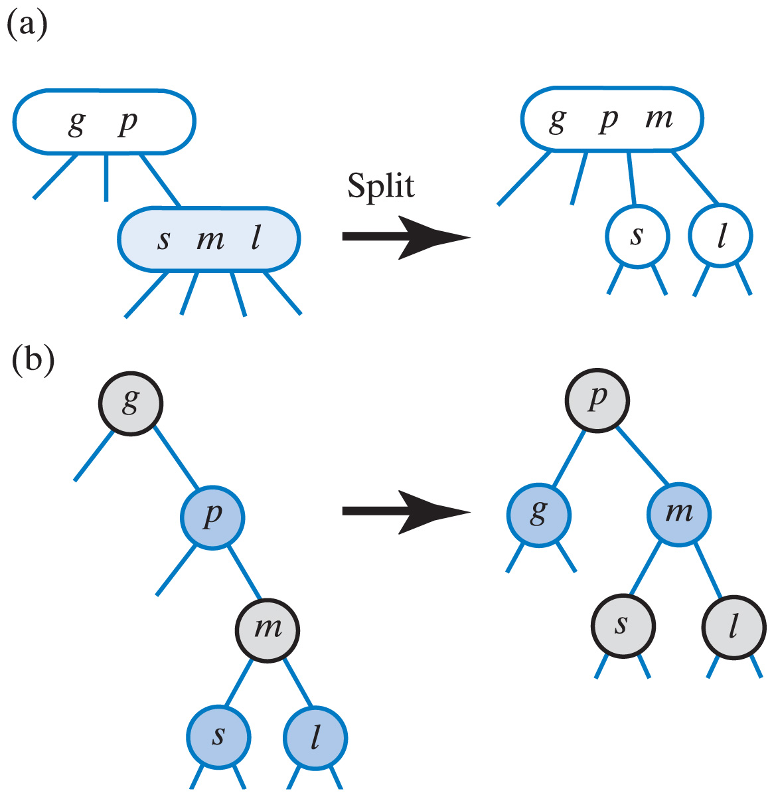
Adding Entries to a Red-Black Tree
Fig. 29-34 Splitting a 4-node that has a 3-node parent with (a) a 2-4 tree; (b) a red-black tree.
Carrano, Data Structures and Abstractions with Java, Second Edition, (c) 2007 Pearson Education, Inc. All rights reserved. 0-13-237045-X

Slide 53
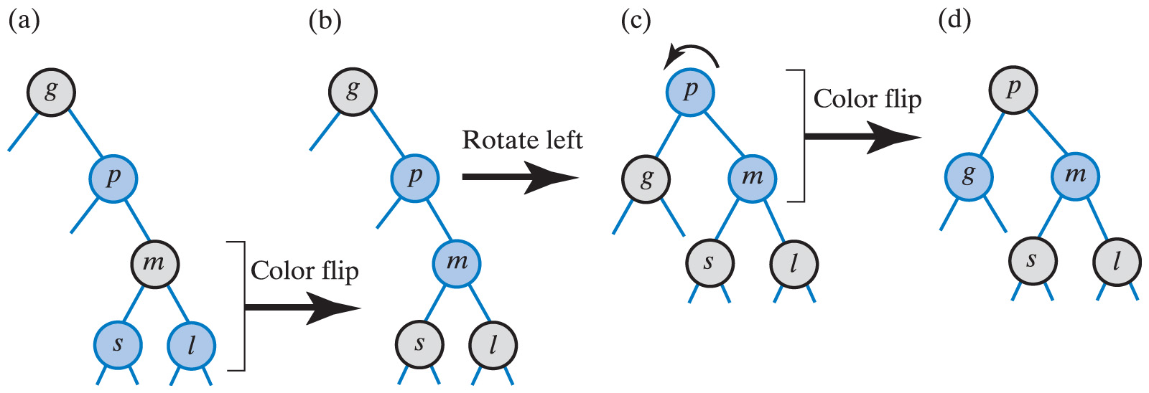
Adding Entries to a Red-Black Tree
Fig. 29-35 Splitting a 4-node that has a red parent within a red-black tree: Case 1.
Carrano, Data Structures and Abstractions with Java, Second Edition, (c) 2007 Pearson Education, Inc. All rights reserved. 0-13-237045-X

Slide 54
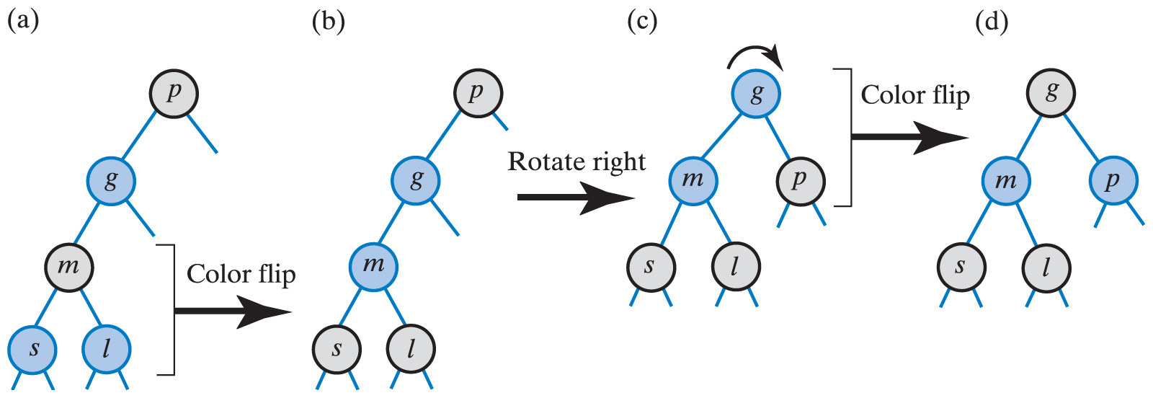
Adding Entries to a Red-Black Tree
Fig. 29-36 Splitting a 4-node that has a red parent within a red-black tree: Case 2.
Carrano, Data Structures and Abstractions with Java, Second Edition, (c) 2007 Pearson Education, Inc. All rights reserved. 0-13-237045-X

Slide 55
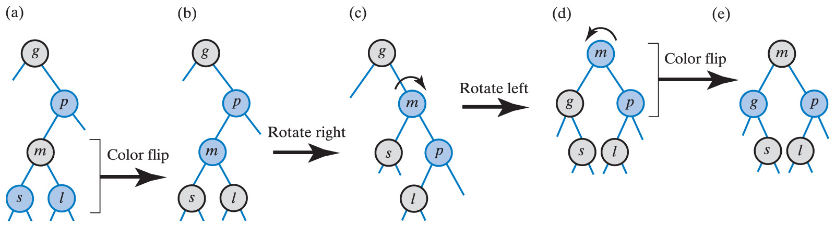
Adding Entries to a Red-Black Tree
Fig. 29-37 Splitting a 4-node that has a red parent within a red-black tree: Case 3.
Carrano, Data Structures and Abstractions with Java, Second Edition, (c) 2007 Pearson Education, Inc. All rights reserved. 0-13-237045-X

Slide 56
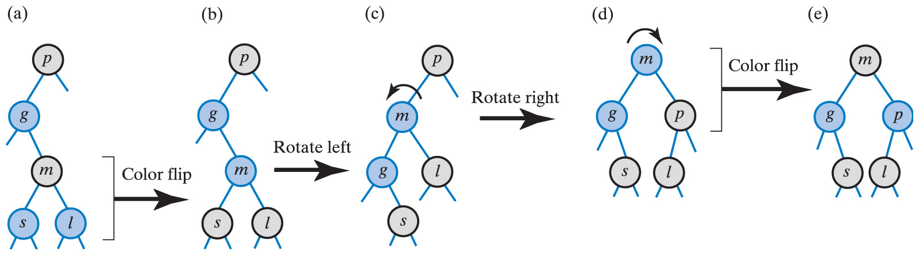
Adding Entries to a Red-Black Tree
Fig. 29-38 Splitting a 4-node that has a red parent within a red-black tree: Case 4.
Carrano, Data Structures and Abstractions with Java, Second Edition, (c) 2007 Pearson Education, Inc. All rights reserved. 0-13-237045-X

Slide 57
Java Class Library:
The Class TreeMap
Uses red-black tree to implement methods in java.util.SortedMap
Extends interface Map
  Similar to our interface for ADT dictionary
  Specifies that search keys maintained in ascending order
Efficiency of get, put, remove, containsKey
  O(log n)
Carrano, Data Structures and Abstractions with Java, Second Edition, (c) 2007 Pearson Education, Inc. All rights reserved. 0-13-237045-X

Slide 58
B-Trees
B-tree of order m
  Balanced multiway search tree of order m
Properties for maintaining balance
  Root has either no children or between 2 and m children
  Other interior nodes (nonleaves) have between m/2 and m children
  All leaves are on the same level
High order B-tree works well when tree maintained in external (disk) storage.
Carrano, Data Structures and Abstractions with Java, Second Edition, (c) 2007 Pearson Education, Inc. All rights reserved. 0-13-237045-X

